Slide 1
Diabetes Prevention and Management: Tips for Taking Control
Courtney Melrose MPH, RD, CDE
Naomi Berrie Diabetes Center
February 7, 2018

Slide 2
Tips for Diabetes Management and Prevention
6
Achieve and maintain a healthy weight
Add more movement and activity to your day
Eat a well-balanced diet
Avoid large quantities of sugar, processed carbohydrates
Reduce sodium intake
Cut down on saturated and trans fats and increase unsaturated fats

Slide 3
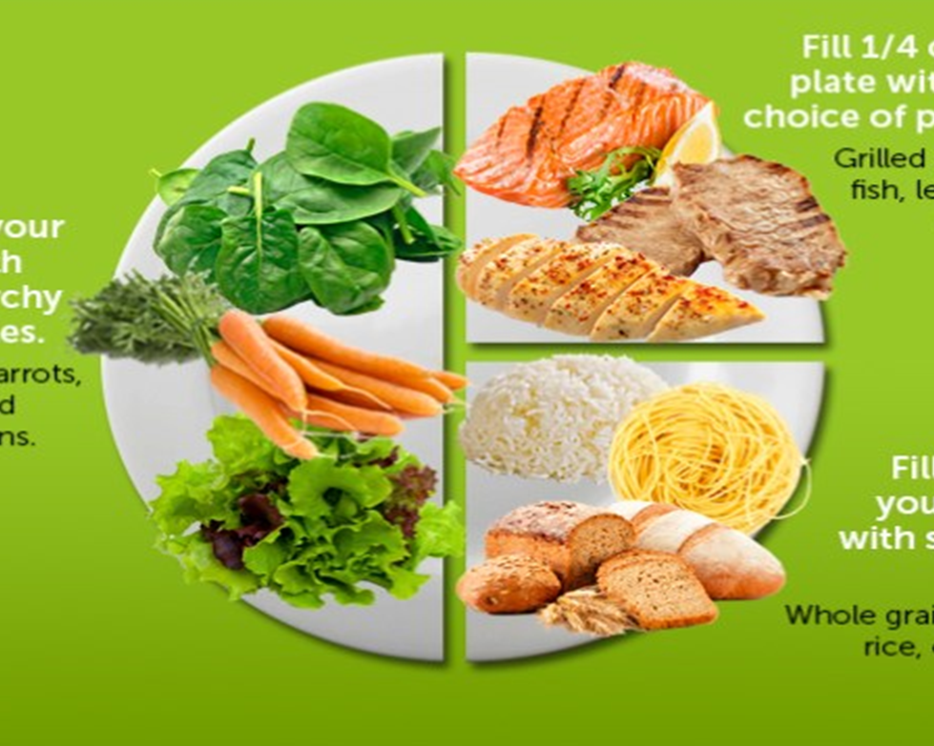
My Plate Method
Planning your meals ahead for the week can ensure you reach your 80% balance target!
Plate yourself this way at least 80% of the time to achieve a good balance to your meals
No need for measuring cups, your body is built with them!
Notes:
Don’t forget about healthy snacking. If you are cutting down on your meal size portions, you may need to include some healthy snacks in between meals to stay satiated.

Slide 4
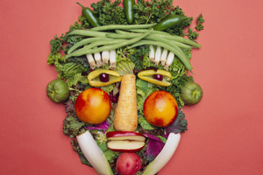
Nutrients in Foods
There are 3 main nutrients in food:
1. Carbohydrates
2. Proteins
3. Fats

Slide 5
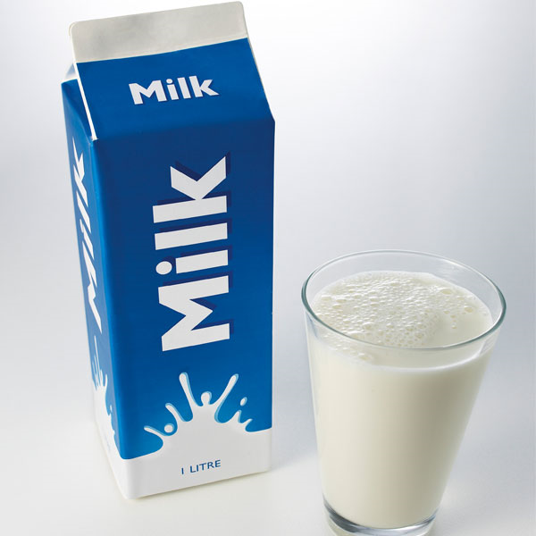
Carbohydrates
Starches
Bread Peas
Pasta Grains
Rice Beans
Potato Legumes
Corn
Sugars
Candy
Pastry
Fruit
Milk
Frozen treats
Sugary Beverages
Fiber
Whole grains
Whole fruits
Vegetables
Nuts/seeds
Legumes
Lentils
Notes:
Whole grains=

Slide 6
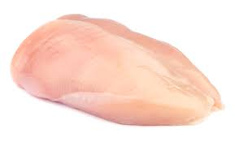
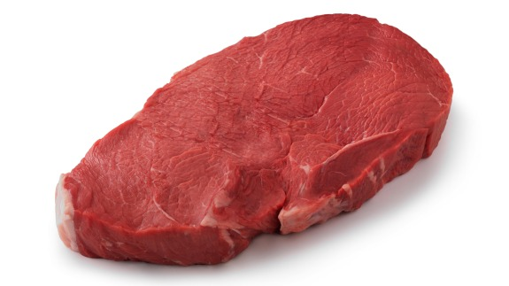
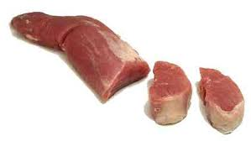
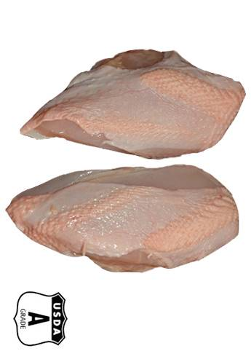
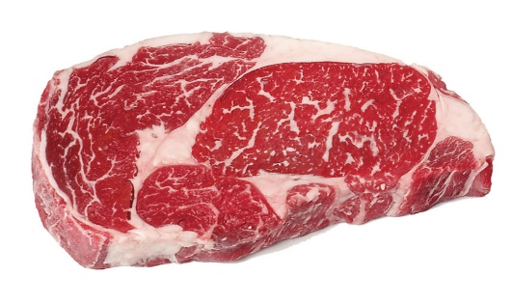
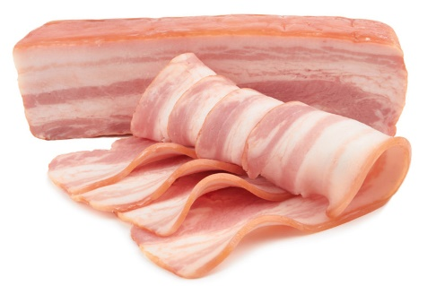
Protein
Choose lean proteins such as skinless chicken/turkey, lean pork, lean beef
Choose FISH 2-3x per week if possible. Salmon, lake trout, herring, albacore tuna, sardines, and mackerel are best
Limit red meats (beef, lamb, pork) to 1-2 meals per week
Avoid processed meats as much as possible. Examples include: most deli meats, ham, bacon, pastrami, salami, hot dogs, pepperoni, and sausages.
Boneless skinless chicken breast
Top sirloin beef steak
Pork tenderloin
vs.
vs.
vs.
Chicken breast with skin on
Marbled rib-eye beef steak
Pork belly/Bacon
Notes:
(TIP: “lean” cuts of pork and beef usually have the word “loin” or “round” in them –try sirloin, tenderloin, eye of round, bottom round, or top round).

Slide 7
Fats
Saturated Fat
Mainly comes from animal products and most are solid at room temperature. They include foods such as:
Meats, deli meats
Visible fat on cuts of meat
Real butter
Full-fat dairy products
Cheese
Chicken skin or turkey skin
Coconut and palm oils
Fried foods
Should be limited
Un-saturated Fat
Known as “GOOD” fats that promote heart health and may lower total and LDL cholesterol and raise good HDL cholesterol levels
Choose mostly these (monounsaturated and omega-3 polyunsaturated):
Olives/olive oil, peanut oil, canola oil
Nuts: walnuts, almonds, pecans
Avocado
Fatty fish: salmon, tuna
Seeds: ground flax, chia
Notes:
(TIP: “lean” cuts of pork and beef usually have the word “loin” or “round” in them –try sirloin, tenderloin, eye of round, bottom round, or top round).

Slide 8
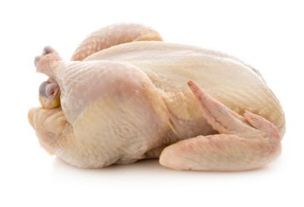
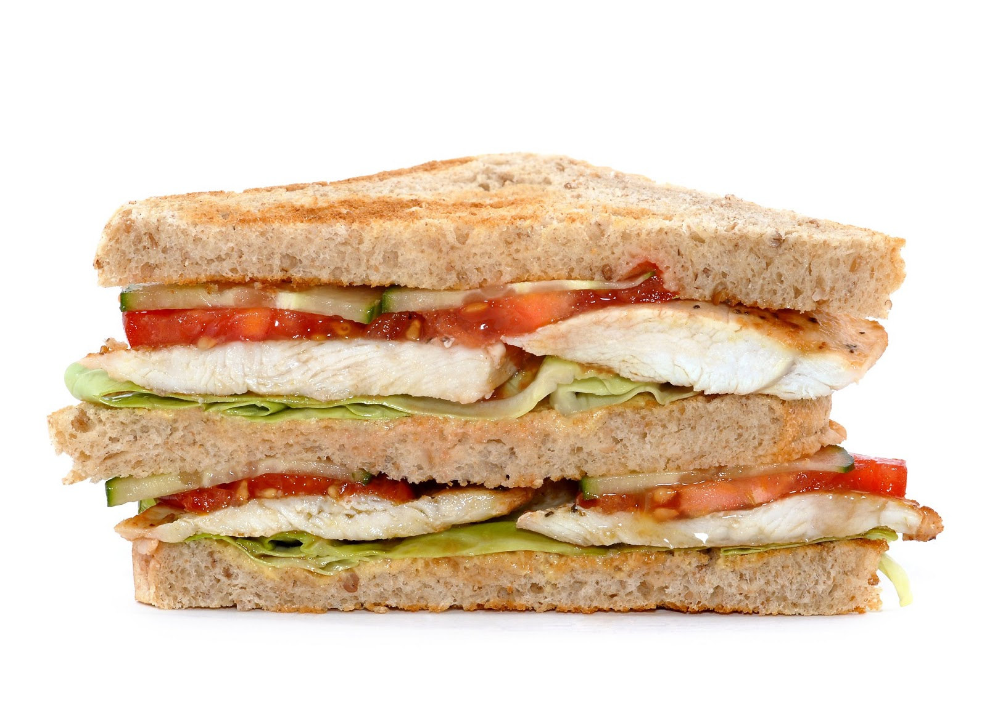
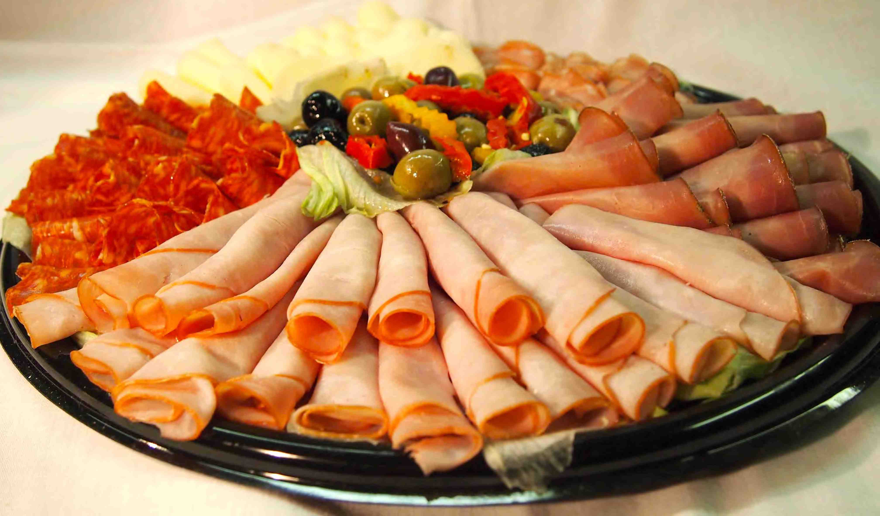
Sodium
More than 75 percent of the sodium Americans eat comes from processed, prepackaged and restaurant foods – not from the salt shaker.
Current recommendation: less than 2400mg per day (ideally, no more than 1500mg!!)
The average American eats more than 3400mg of sodium a day
1 tsp of table salt = 2300mg sodium
Reducing sodium in your diet may help reduce blood pressure in those at risk or who have been diagnosed with high blood pressure
Check Nutrition Fact labels for more information: a low-sodium food has 140 mg per serving or less
Be aware of The Salty Six

Slide 9
My Plate Method
Planning your meals ahead for the week can ensure you reach your 80% balance target!
Plate yourself this way at least 80% of the time to achieve a good balance to your meals.
No need for measuring cups, your body is built with them!
Notes:
Don’t forget about healthy snacking. If you are cutting down on your meal size portions, you may need to include some healthy snacks in between meals to stay satiated.

Slide 10
Weight Loss and Activity
The CDC: Centers for Disease Control and Prevention
recommends for adults (ages 18-64):
2 hours and 30 minutes (150 minutes) of moderate-intensity aerobic activity (i.e., brisk walking) every week
AND
weight training/muscle-strengthening activities on 2 or more days a week that work all major muscle groups (legs, hips, back, abdomen, chest, shoulders, and arms)
Notes:
In most of the diabetes prevention studies, this was the recommendation used as a part of the lifestyle modification portion. Those who achieved this, were much more likely to reach their weight loss goal.

Slide 11
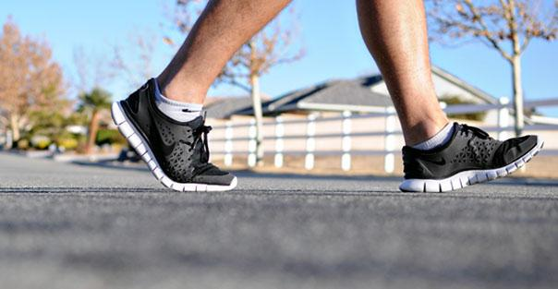
Weight Loss and Activity
√ Check with your doctor to make sure exercise is safe
√ Add activity to your day
√ Create a fun, low-impact walking plan
√ Set realistic goals and chart your progress
√ Ease your way into more physical activity

Slide 12
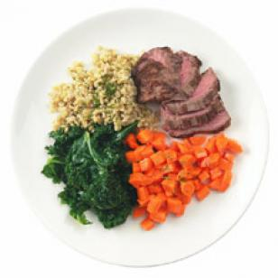
Weight Loss and Activity
+
=
Balance of food and body movement helps everyone, but it can help you reach your goal with blood sugars too.
Losing a modest amount of weight (~5-7% of your body weight) can be enough to help your body better use the insulin you still make. It could also lead to needing less medication.
EXAMPLE: A 200lb person would need to lose between 10 and 14lbs in order to get this benefit.
Notes:
Go over car and gravel analogy

Slide 13
Wrap Up
Achieve and maintain a healthy weight
Add more movement and activity to your day
Eat a well-balanced diet
Avoid large quantities of sugar, processed carbohydrates
Watch Sodium Intake
Cut down on saturated and trans fats and increase unsaturated fats

