Slide 1
Heart Health & Diabetes
Nisha Jhalani, MD
Director, Women’s Heart Health Initiative
Cardiovascular Research Foundation
Assistant Professor of Medicine
Columbia University Irving Medical Center

Slide 2
The Scary Facts
Heart disease is the #1 killer of both men and women in the US
Heart disease affects people with diabetes at a younger age
The longer someone has diabetes, the higher the chances they will develop heart disease
Diabetics have a 2 to 4-fold increase in the risk of CAD or PAD
Diabetes is a coronary risk equivalent to known CAD
This is now true for about half of women and 2/3 of men
Diabetics are more likely to have multi-vessel coronary artery disease
Diabetics have a worse prognosis after having a heart attack
Notes:
Younger age --- being a woman is no longer protective.
Risk equivalent is no longer true
About ½ of women and 2/3 of men

Slide 3
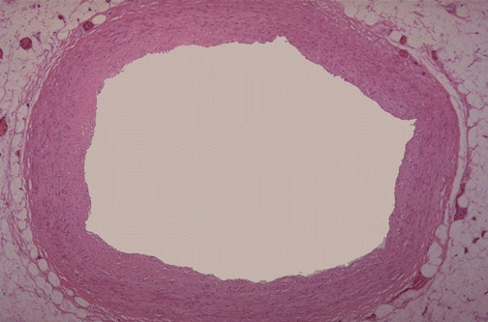
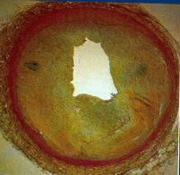
Atherosclerosis = “hardening of the arteries”

Slide 4
Diabetes and Atherosclerosis
Microvascular Complications
Retinopathy
Nephropathy
Macrovascular Complications
Coronary artery disease
Peripheral arterial disease
Carotid disease
Notes:
Glycemic control limits microvascular disease, no established benefit in reducing macrovascular disease

Slide 5
Pathophysiology of Atherosclerosis in Diabetes
Plaque in diabetics is not the same as plaque in nondiabetics!
Diabetes makes blood more prone to clotting and plaque rupture
Diabetes negates the beneficial/protective effects of HDL cholesterol
Diabetics have higher small dense LDL, even with normal LDL levels
Notes:
Chronic hyperglycemia, dyslipidemia, insulin resistance

Slide 6
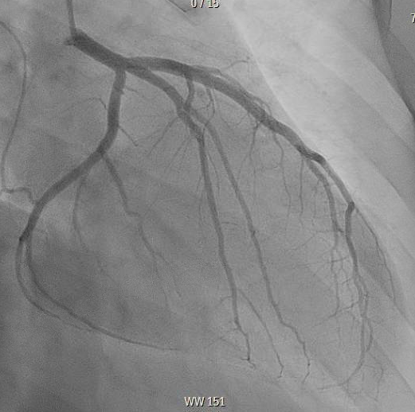

Slide 7
Coronary Artery Disease
Diabetics are more likely to present with:
“Atypical” angina
Shortness of breath
Nausea or vomiting
Abdominal pain
Lightheadedness
Sweating
Weakness
Palpitations
Notes:
Definition of atherosclerosis – plaque buildup/hardening leading to stenosis vs plaque rupture
Neck/Shoulder/Arm/Back/Jaw
More likely to have stress-induced symptoms

Slide 9
Prevention of Cardiovascular Disease in Diabetics
Emphasis on diet and physical activity
“Sitting is the new smoking”
Metformin is first line
Improves insulin resistance and reduces macrovascular events
Second line: consider those with proven CV benefit
SGLT-2 inhibitors: empaglifozin (Jardiance)
GLP-1 inhibitors: liraglutide (Victoza) and semaglutide (Ozempic)
Notes:
High protein, low carb diet

Slide 10
Prevention of Cardiovascular Disease in Diabetics
Aspirin if age > 50
Blood pressure control with goal <130/80
ACE inhibitors (ACEi) “-pril”
HOPE study: reduced stroke, MI and death in patients with DM and 1 other risk factor
Angiotensin receptor blockers (ARBs) “-sartan”
LIFE study: reduced mortality in diabetics with HTN and left ventricular hypertrophy
Notes:
Vigorous BP control reduced rates of heart events in diabetics more than in nondiabetcs

Slide 11
Statin Therapy in Diabetics
Risk factor | Age | Statin intensity
History of atherosclerotic CVD | All age groups | High-dose statin
CVD risk factor† | <40 or >75 | Moderate or high
 | 40-75 | High dose
No risk factor | <40 | None
 | 40-75 | High dose
 | >75 | Moderate or high
Standards of medical care in diabetes--2017: summary of revisions. Diabetes Care 2017;40:S4-5

Slide 12
Risk Factors for Heart Disease
Modifiable
Non-modifiable
Diabetes
High blood pressure
High cholesterol
Smoking
Obesity/abdominal fat
High stress
Poor sleep habits
Depression
Age
Race
Family history
Male sex
Pre-eclampsia or gestational diabetes

Slide 13
The Link Between Diabetes and Heart Disease
Diabetes is a major risk factor for heart disease due to increased atherosclerosis
Plaque in diabetics behaves differently than nondiabetics
The key to preventing heart disease in diabetes is healthy lifestyle habits and aggressive control of the other risk factors
Treatment of a diabetic patient involves a team-based approach and regularly scheduled outpatient follow-up appointments

Slide 14
Join us to help #defyheartdisease
Follow us on Twitter
@CRFheart
@nishajhalani

